Slide 1
Hyponatremia 501: DDAVP CLAMP
Brian Locke, MD MSc
Intermountain Medical Center
Notes:
TODO
Karl point: is the congestion thing really a problem? Say you turn on ADH but give a diuretic… will your urine output actually change, and would it matter [ie. would natriuresis change?] – is there any data on what the usual ADH strategy is?
Meme: The overall insight is that SIADH is predictable to treat…. And often quite simple once the diagnosis is made. Thus:
So, what you are essentially doing is replacing an unpredictable-to-treat etiology with a predictable one.
Meme:
Step 1: cause SIADH
Step 2: treat the SIADH you caused.
Step 3: Profit.
2 other resources to review and add:
https://pubmed.ncbi.nlm.nih.gov/33999276/?dopt=Abstract
https://annalsofintensivecare.springeropen.com/articles/10.1186/s13613-022-01024-6

Slide 2
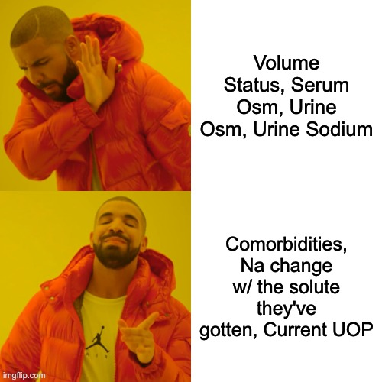
Roadmap
Why is the clamp helpful?
When should you clamp?
How should you clamp?
Does anything matter?

Slide 3
Two ways to get hyponatremic:
Hyponatremia Schema
Homeostasis Overwhelmed | Anti-Diuretic Hormone
Appropriate response, but insufficient. | Kidney causes water retention
Too much free water to handle Carbs, Fat, EtOH → CO2+H2O Frail Kidneys | ADH (vasopressin) being used as an endogenous pressor ADH inappropriately there
Low Urine Osm / spec grav How low the urine osm & UOP differentiates | High Urine Osm / spec grav Urine Na differentiates
Notes:
Math:

Slide 4
Homeostasis Overwhelmed
60 kg person with an average diet: 600 mOsm/d solute.
Healthy individual:
max urine osm = 1200 mOsm/L → ____ L/d of urine?
min urine osm = 50 mOsm/L → ____ L/d of urine?

Slide 5
Homeostasis Overwhelmed
60 kg person with an average diet: 600 mOsm/d solute.
Healthy individual:
max urine osm = 1200 mOsm/L → 0.5 L/d of urine (~= 50cc/hr, coincidence?)
min urine osm = 50 mOsm/L → 12 L/d of urine? (~=500cc/hr)
more than 12L of daily intake? hyponatremia
What is the maximum intake if:
*Minimum urine osm increases to 100? 200? 400?
**Solute intake doubles? Solute intake halves?
Minimum urine osm increases to 100 & 2x solute intake? 100 & ½ solute?
GFR is too low to make 12L of urine? (AKI, CKD/Old age)
*What happens when we give ADH
**What happens when in ICU (NS…)
Notes:
Urine osm 100 = 6L, 200 = 3L, 400 = 1.5L
2x solute intake = 24L, 1/2x solute intake = 6L
2x solute + osm 100 = no change; and ½ = 3L

Slide 6
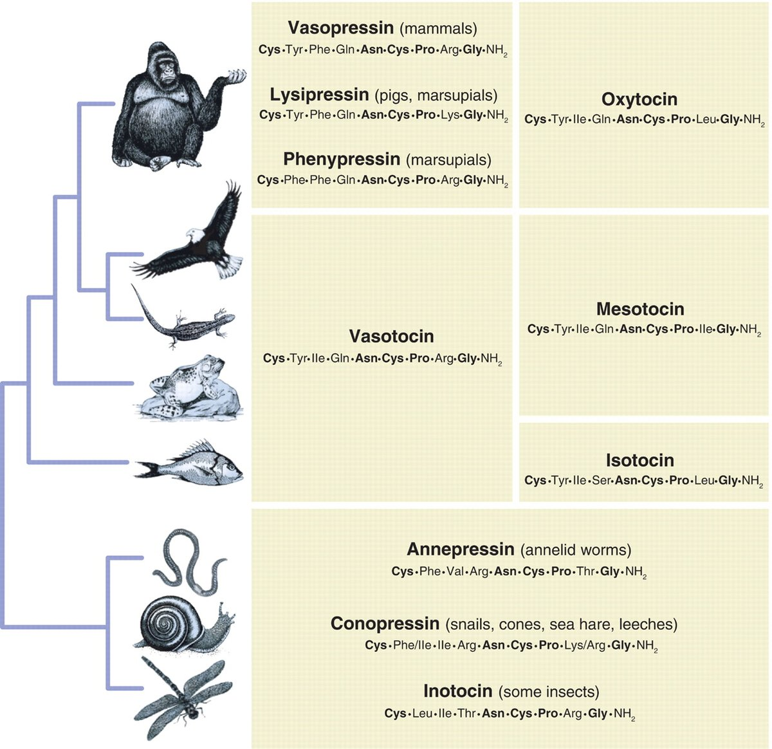
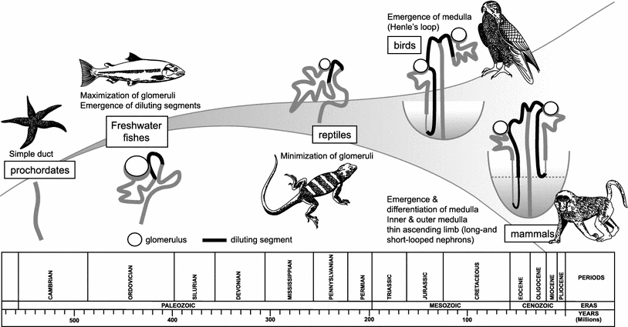
Arginine Vasopressin = Anti Diuretic Hormone
Why did we evolve a vasopressor to retain free water?
Notes:
Oxytocin & vasopressin – gene 20, duplication
https://t.co/RKEGgToFLz
Then – when amphibeans evolved to land = needed osmoregulation. Urothelium became sensitive to ADH
https://t.co/0MlbEpWUMt
Evolutionary point is to say: if you’re losing so much volume that you’re underperfusing your kidneys - you’ll sacrifice tonicity for any attempt at volume restoration. Kidneys protect their own.

Slide 7
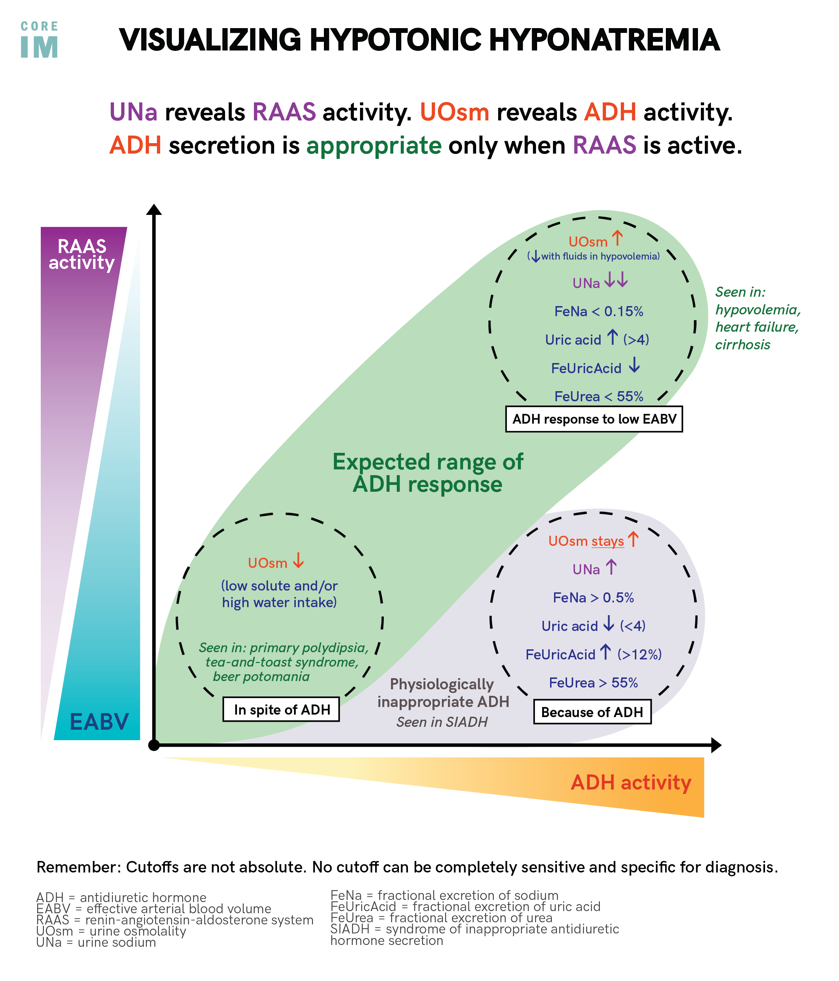
Body using ADH as a Vasopressor
Urine Osm, Urine Na describe a physiologic state, not a diagnosis.
Physiologic states change
Repeat labs if you need to
Kidneys trying, but overwhelmed
Inappropriate ADH
Notes:
https://twitter.com/COREIMpodcast/status/1552252666486693891?s=20&t=FY4wH6UpeCJDE8T_i_sQYA
Addison’s disease just looks like SIADH because actually the kidneys just can’t reabsorb the sodium (so the ADH might be physiologic, but the Na wasting isn’t)

Slide 8
What happens when they get NS in the ED?
If ADH is present, urine output will be low and urine will be concentrated.
Very little free water is excreted, serum Na won’t rise.
If ADH is absent, urine output will be high (if GFR is) and urine will be dilute.
Lots of dilute urine = serum sodium rises.
Unless using hypertonic, this is the ONLY way Na rapidly corrects.
Homeostatic Overload | Inappropriate ADH | ADH as Vasopressor
GFR OK and kidneys work = very brisk UOP, rapid rise [ADH was never present] | ADH present before and after = little UOP or raise in Na | If body no longer needs ADH as pressor = turns off, brisk UOP and Na rise. [Cardiorenal+Hepatorenal = ADH remains on]

Slide 9
Flip the Script
Options:
Polydipsia
Tea & Toast / Beer Potomania
Kidneys that don’t work good
Cardiorenal
Hepatorenal
Hypovolemia
SIADH
A patient comes in with a Na of 120 and receives 1L of NS. What’s on the DDx if:
UOP 300/hr Na rockets up | UOP 50/hr Na jumps by 5 | UOP 50/hr Na doesn’t change | UOP 50/hr Na drops

Slide 10
Flip the Script
Options:
Polydipsia
Tea & Toast / Beer Potomania Kidneys that don’t work good
Cardiorenal
Hepatorenal
Hypovolemia
SIADH
A patient comes in with a Na of 120 and receives 1L of NS. What’s on the DDx if:
UOP 300/hr Na rockets up | UOP 50/hr Na jumps by 5 | UOP 50/hr Na doesn’t change | UOP 50/hr Na drops
Polydipsia Tea & Toast / Beer Potomania Hypovolemia [adh turned off] | Kidneys don’t work good (+/- any of left column) | ADH still present: SIADH (min u_osm ~300) Cardiorenal Hepatorenal [hypovol insufficient] | SIADH

Slide 11
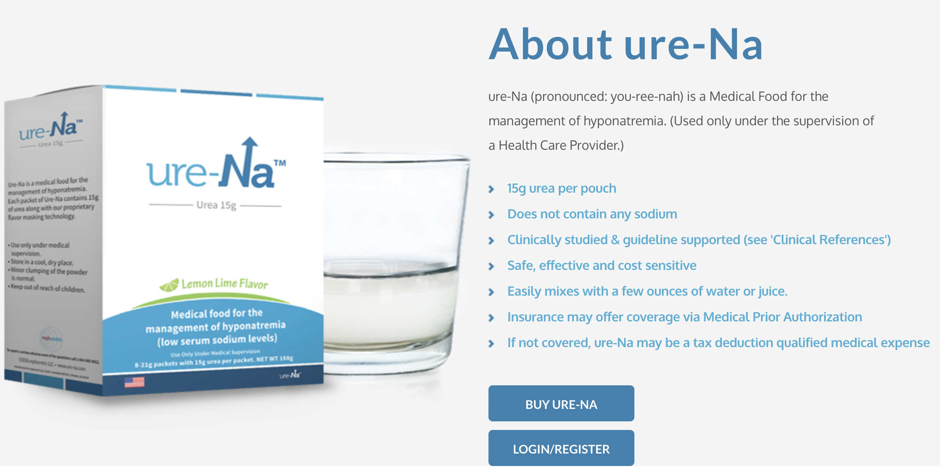
Revisiting SIADH treatment
Less ADH = low min osm. More ADH = higher min osm.
What is the maximum intake if (normal = 12L max, 50 mOsm min urine osm):
*Minimum urine osm increases to 100? 200? 400?
6L, 3L, 1.5L
**Solute intake doubles? Solute intake halves?
2x (24L), 1/2x (6L)
What are the two ways to treat SIADH?

Slide 12
Giving DDAVP (ADH)
Why?
Cause SIADH = can’t overcorrect.
Then treat SIADH by either fluid restricting, giving solute, or both.
ALL the risk of over-correction comes from solute being given when ADH is low (= body can now dump free water at U_osm 50 osm/L)
Adrogue-Madias equation: 1L NS in 70kg w/ Na 105 -> 107.5
Overcorrection can only occur with brisk UOP (or over 1L of 3% /d in 70kg!)
Notes:
(http://touchcalc.com/calculators/adrogue)

Slide 13
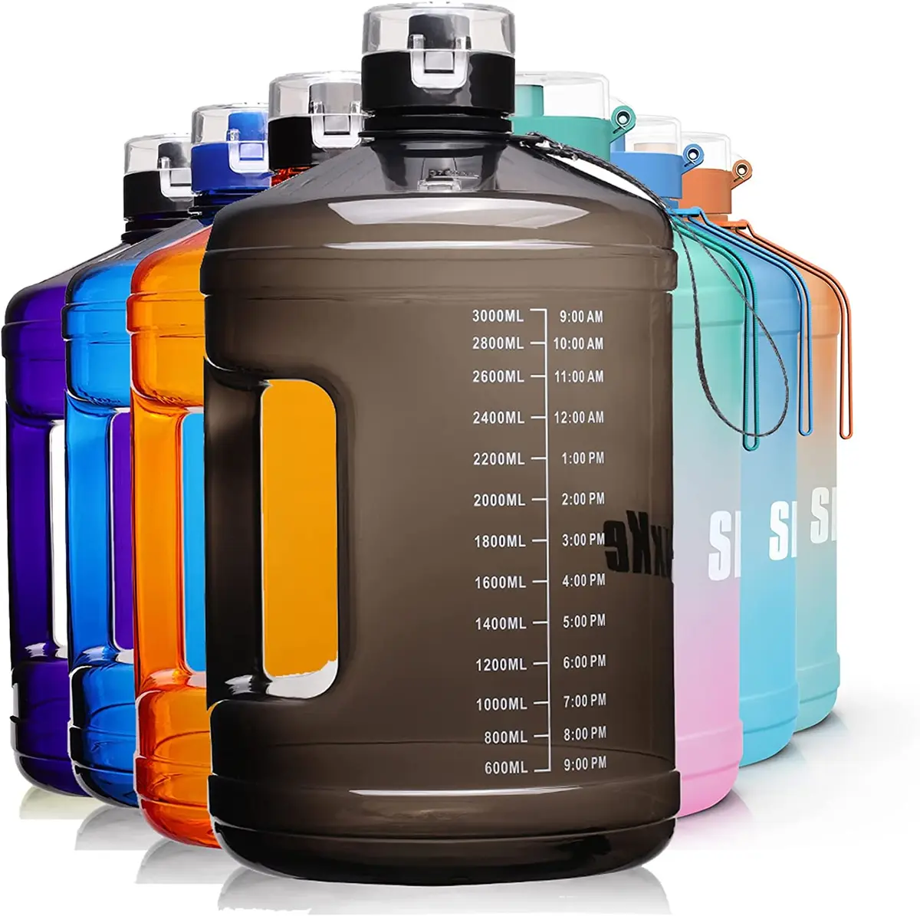

Case 1:
Dx is psychogenic polydipsia. 15L/d. Na = 120.
Is ADH high or low? (urine osm)
UOP is high or low before we act?
What would happen if you gave NS?
UOP: Serum Na:
What would happen if you gave DDAVP + NS/HS?
UOP: Serum Na:

Slide 14
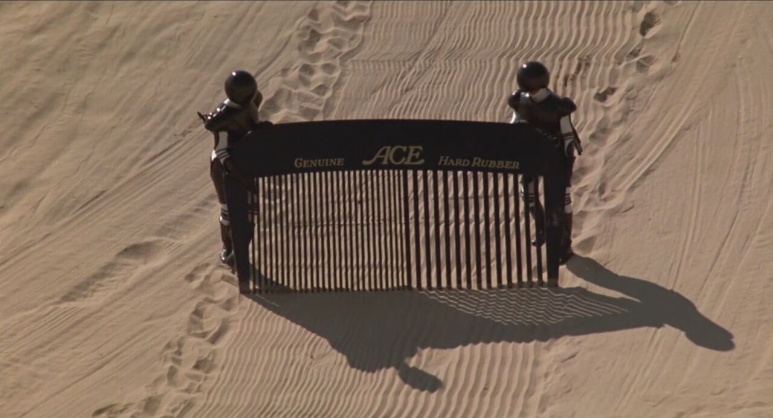
Case 2:
Profoundly dehydrated. Na = 120.
Is ADH high or low? (urine osm)
UOP is high or low before we act?
What would happen if you gave NS?
UOP: Serum Na:
What would happen if you gave DDAVP + NS/HS?
UOP: Serum Na:

Slide 15
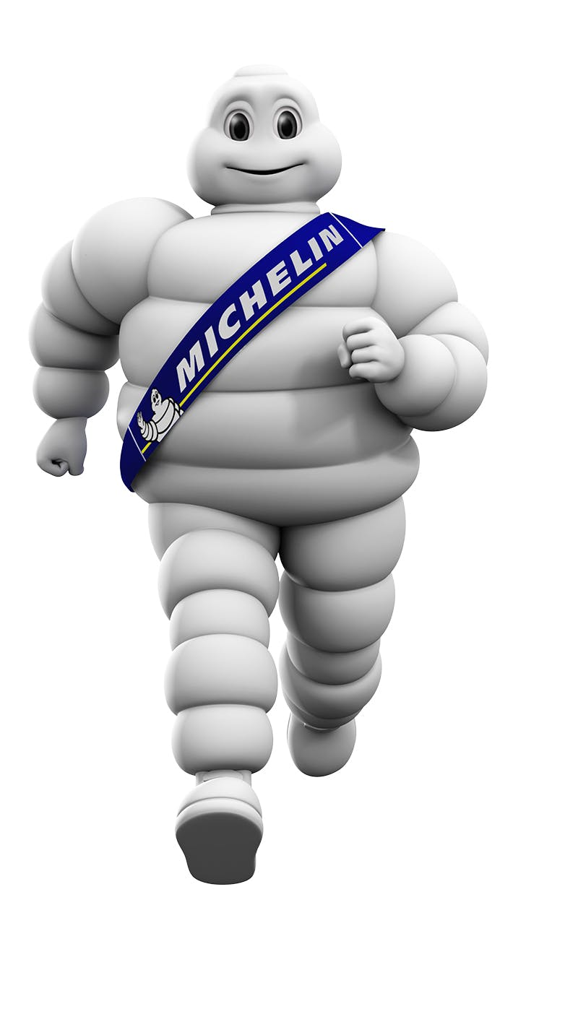
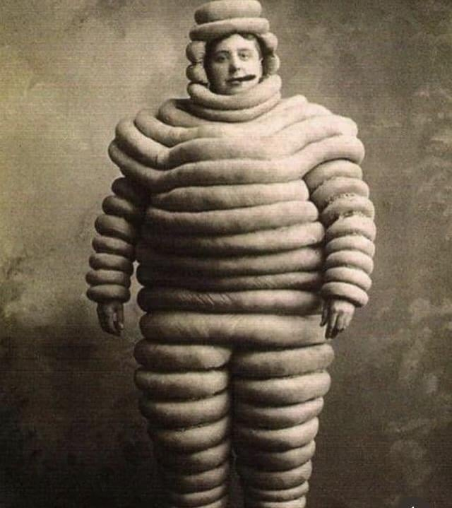
Case 3:
CHF and cardiorenal synd. Na = 120.
Is ADH high or low? (urine osm)
UOP is high or low before we act?
What would happen if you gave NS?
UOP: Serum Na:
What would happen if you gave DDAVP + NS/HS?
UOP: Serum Na:

Slide 16
When to clamp
When to Consider the Clamp | When it doesn’t matter | When not to clamp
Situations where ADH is off or going to turn off*: Polydipsia Tea and Toast / Beer Potomania Hypovolemia or correctable ↓EABV | SIADH (makes no physiologic difference because they’re already ‘clamped’) Hepatorenal (they’re clamped and it’ll be hard to fix) Low GFR (won’t overcorrect anyway) | Cardiorenal (it will get in the way of decongesting)
*2 options for when ADH is off:
Limit solute, give back D5W to match the urine output
Give ADH back

Slide 17
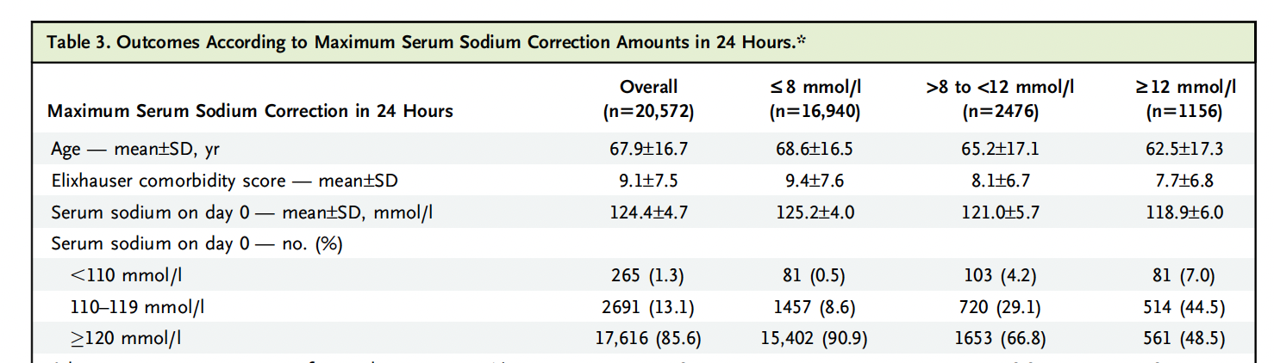
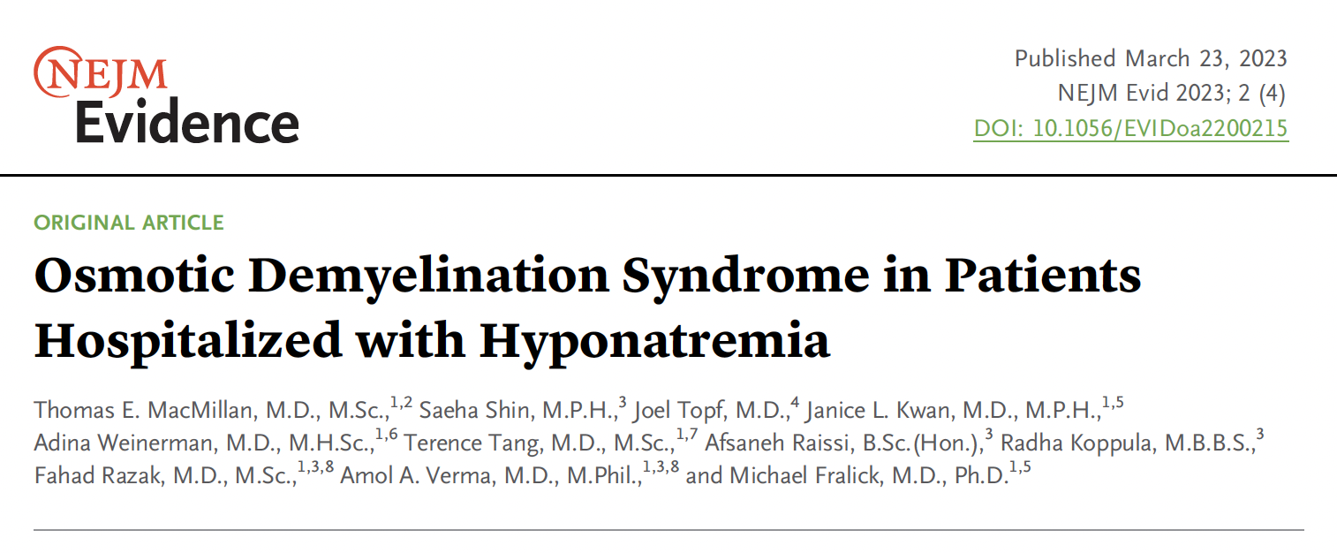
2 paths when ADH turns off: commit to one
Without DDAVP Clamp | With DDAVP Clamp
Very strict control of solute Absolutely needs monitoring of UOP (foley) Purpose; assess needed reaction to kidney If managing based on labs, always 4-6h behind | Control of solute is less important Monitoring UOP is less critical Purpose: ensure your intervention is working
May be appropriate for milder hyponatremia and lower potential for over-correction (low GFR, inability to fully suppress ADH) | More appropriate for severe hyponatremia without hypervolemia, high potential for over-correction (high GFR, ability to fully suppress ADH)
Using a “reactive” DDAVP strategy (give DDAVP as needed for over-correction) retains the worst aspects of the standard management.

Slide 18
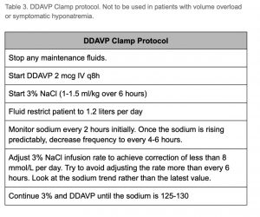
How to DDAVP clamp:
DDAVP 2 mcg IV q8hr, continued until Na at target
Give 3% Saline to increase
Do nothing to keep unchanged
Give D5w to decrease
Notes:
Caveats: KCl needs to be counted; as do medications (don’t put in D5w); restrict oral intake

Slide 19
Hyponatremia Pitfalls
Fixating on the diagnosis, not the physiologic state
Using ”reactive” DDAVP
Not paying attention to the UOP to tell when ADH turned off
Not paying attention to their solute inputs (esp if not clamping).
Plan:
Step 1: Cause SIADH
Step 2: Treat SIADH

Slide 20
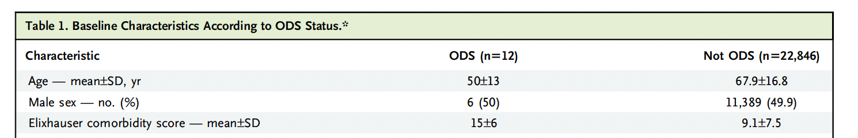
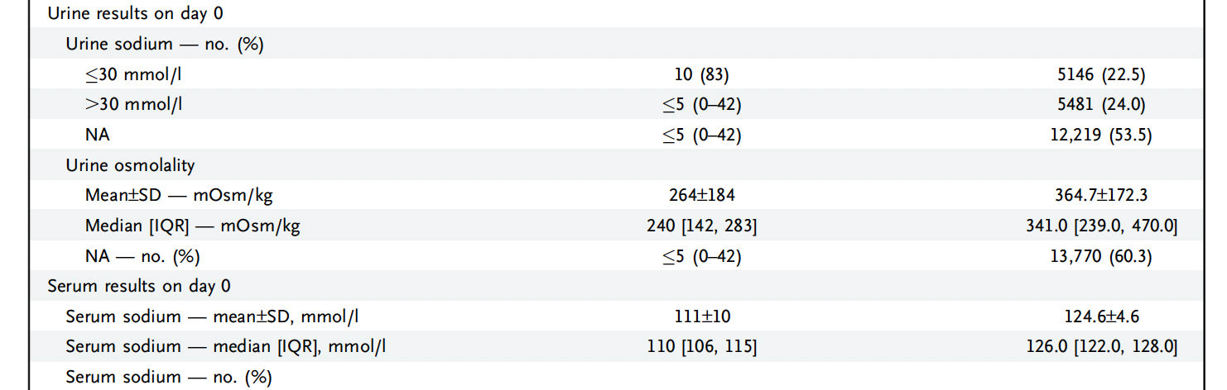
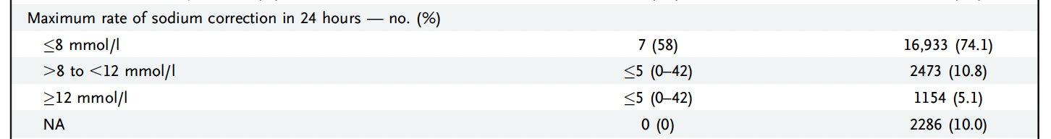
Does anything matter? 2 recent studies:
EHRs of 5 Toronto Hospitals
Inclusion: Inpt, 1st Na <130. 2010—2020. N=22858
Exposure: Na, Comorbs, Corr.
Outcome: ODS on imaging [flag then review] or ICD for ODS.
Results: Mean Na 125. 17.7% over-corrected
30% got CT, 6.6% got MRI ☹
Devastating & Rare = Hard to study
Notes:
Mean Na 125
Change > 8 mmol/d in 17.7%
30% got CT, 6.6% got MRI
9 total cases
0.3% of those < 120 had ODS
NEJM evidence paper interpretation:
- clarify: issues around ascertainment of the outcome may limit the strength of what can be drawn from this… if you do a quasi-sensitivity analysis with the % missed by the scans, there might still be a lot of these.
---→ also, look more into the issue of ascertainment and timeline.
Symptoms delayed up to 2 weeks; 2/3 are (mostly) self resolving.

Slide 21
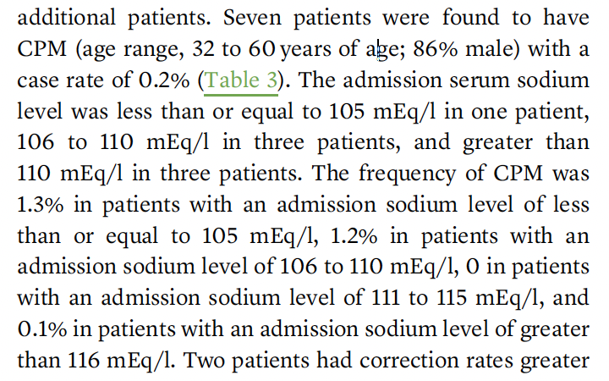
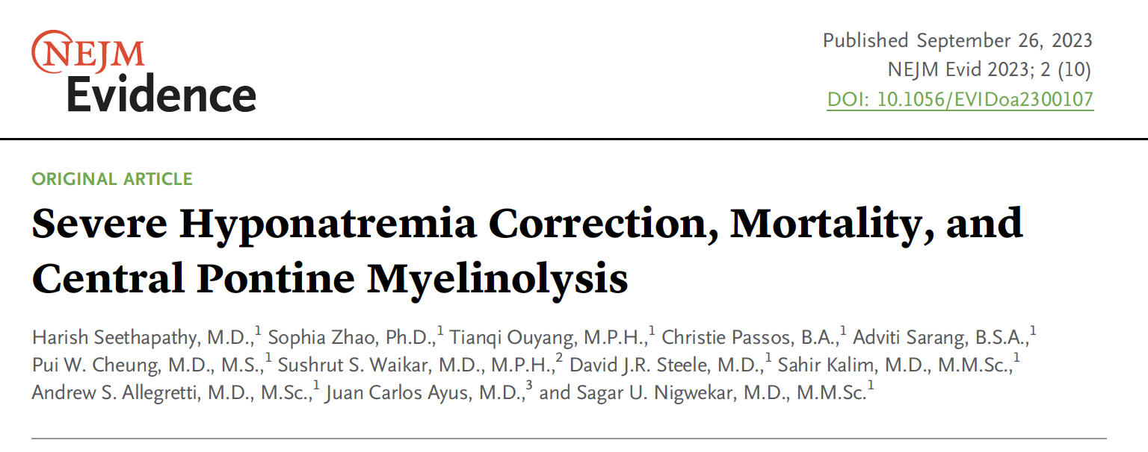
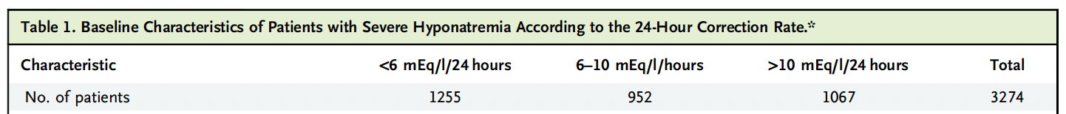
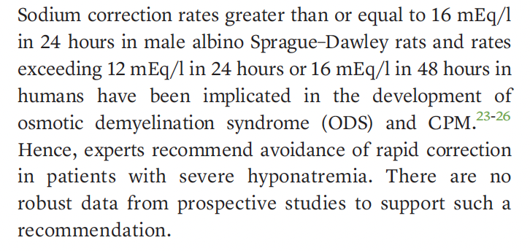
Does anything matter? 2 recent studies:
EHRs of BWH+MGH 1993-2018
Inclusion: Inpt, 1st Na <120. N=3274
Exposure: Na, Comorbs, Corr.
Outcome: CPM (NLP of MRI report), LOS, Mortality
Results: Mean Na 116.
Where did correction → CPM come from?
Notes:
- delve more into the predictors of who might be at high risk and how that ought to inform your approach → make this a main takeaweay – who is at high risk? folks who have the most GFR, lowest Na…. Etoh/nutrition?→ these are likely the ones to focus on the most.
Paine point: considering how rare this outcome is – both imagine how difficult it is to study, and how difficult it would be to show a benefit… [as in, even rare harms to a DDAVP clamp strategy might outweight the benefit in avoidance of over-correction]

Slide 22
Hyponatremia: summary
It is possible we are entirely mistaken about the cause of CPM / ODS
We know very little for certain, other than it is rare.
Na <120 mmol/L, rapid sodium correction, alcoholism, hypokalemia, female, liver transplant
Standard of care, for now, is slow correction.
Probably net positive consequence to abandon this if slow corr causing harm
Tools for residents: Serum Osm, Urine Osm, Urine Na
Tools for fellows: UOP, response to solutes, clinical circumstance, cycling the labs prn
Reactive management is OK if mild, limited GFR/ADH suppression, Hypervolemia
Otherwise, commit to DDAVP + Hypertonic saline proactively

Slide 23
Key References
https://www.coreimpodcast.com/2021/02/10/5-pearls-on-hyponatremia-episode-1/
Desmopressin to Prevent Rapid Sodium Correction in Severe Hyponatremia: A Systematic Review: DOI: 10.1016/j.amjmed.2015.04.040
NEJM Evidence Articles:
McMillan et al. 2022 DOI: 10.1056/EVIDoa2200215
Seethapathy et al. 2023 DOI: 10.1056/EVIDoa2300107

